Slide 1

Analyzing Correlation Patterns to Develop a Fitness Tracker

Slide 2
PROBLEM STATEMENT
Analyzing correlation patterns from fitness device data to gain insight into how consumers are using their smart devices to help a business develop a fitness tracker.

Slide 3

CORRELATION
What is Correlation?
Correlation measures the statistical relationship between two variables. It indicates whether and how much two variables change together.
A positive correlation means that as one variable increases, the other tends to increase as well.
A negative correlation means one variable decreases while the other increases.
The correlation coefficient quantifies this relationship, with values ranging from -1 to 1.
Role of Correlation in our Case Study
Correlation analysis on our dataset can be valuable for uncovering relationships between different variables, which could be useful to develop a fitness tracker.

Slide 4


ABOUT THE DATASET
The Kaggle data set contains personal fitness tracker from thirty fit-bit users.
Thirty eligible Fitbit users consented to the submission of personal tracker data,
including minute-level output for physical activity, heart rate, and sleep monitoring.
It includes information about daily activity, steps, and heart rate that can be used to
explore users’ habits.
dailyAcitivity_merged - 940 rows, 15 columns
dailyCalories_merged - 940 rows, 15 columns
dailyIntensities_merged - 940 rows, 15 columns
heartrate_seconds_merged - 2483658 rows, 3 columns
sleepDay_merged - 413 rows, 5 columns
weightLogInfo_merged - 67 rows, 8 columns

Slide 5
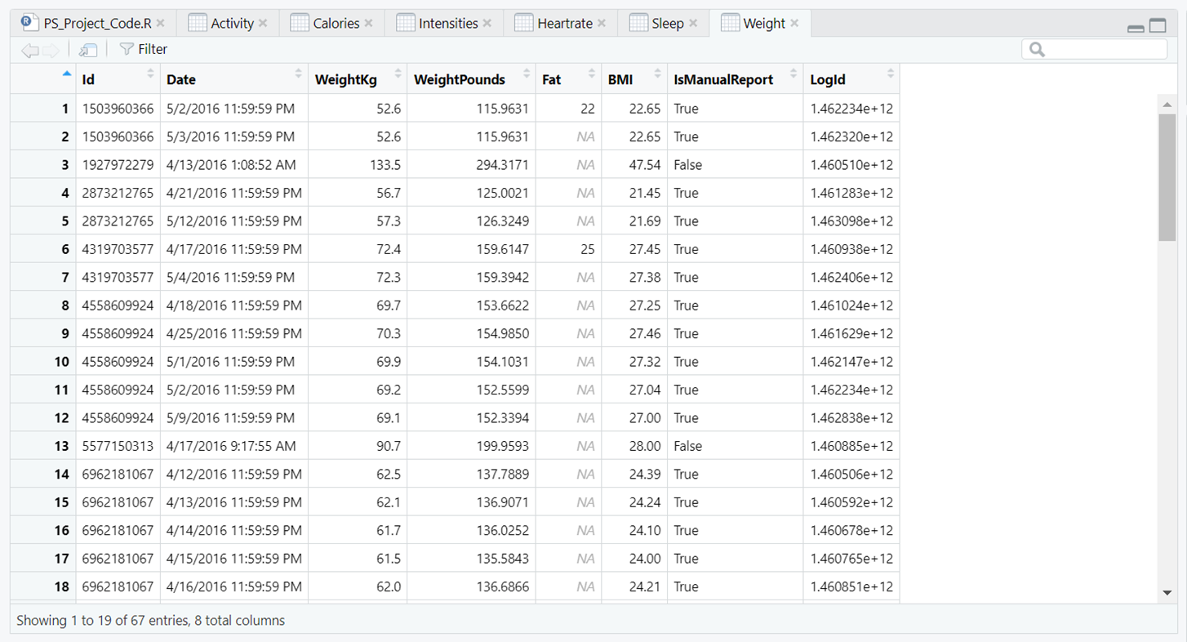
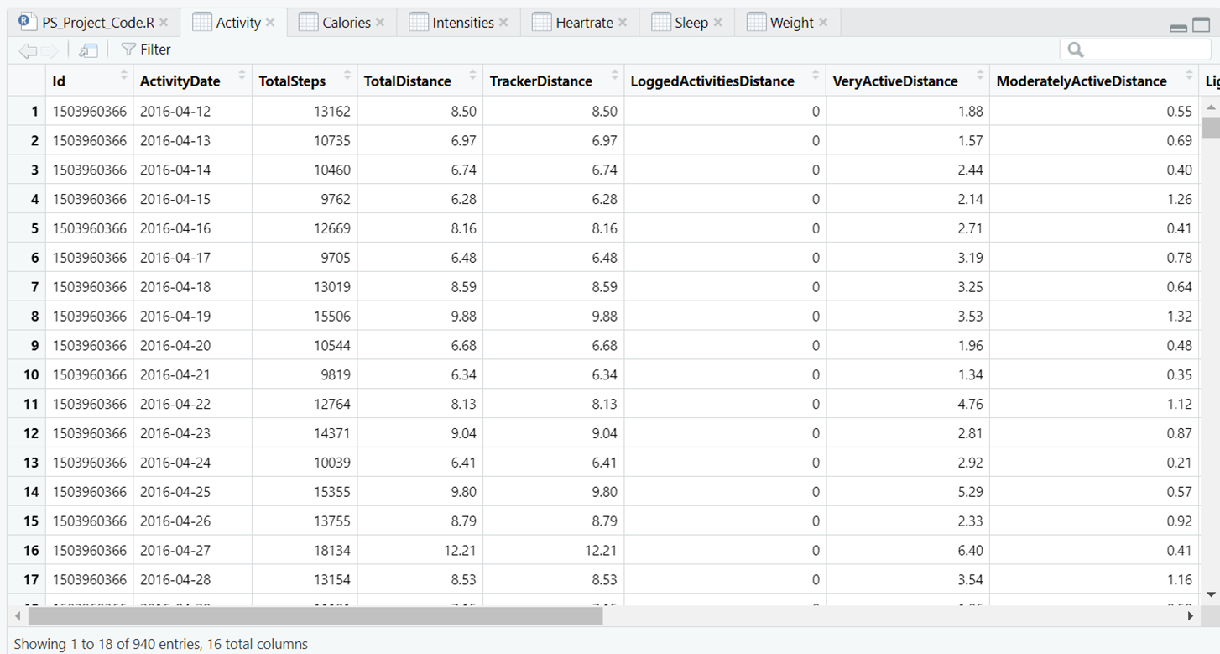
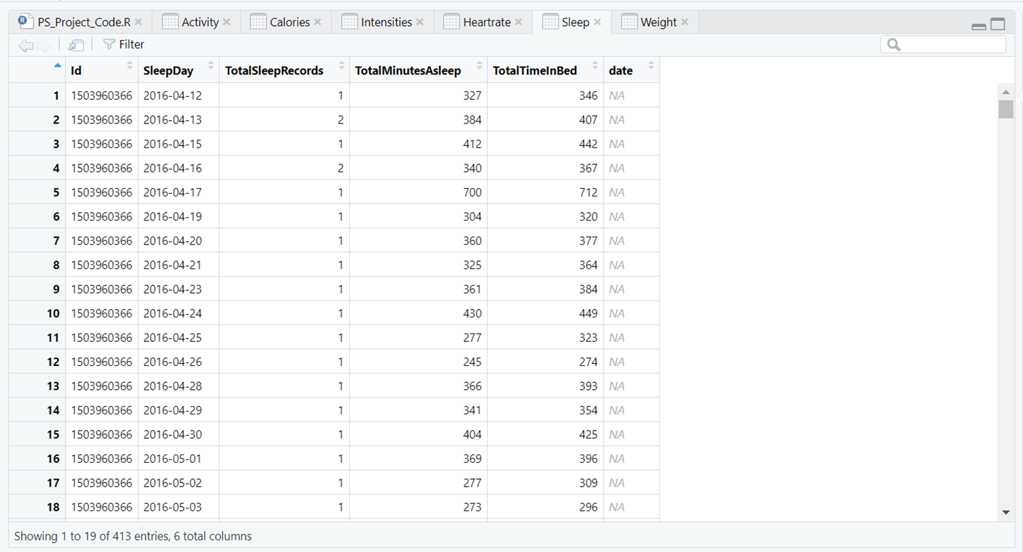
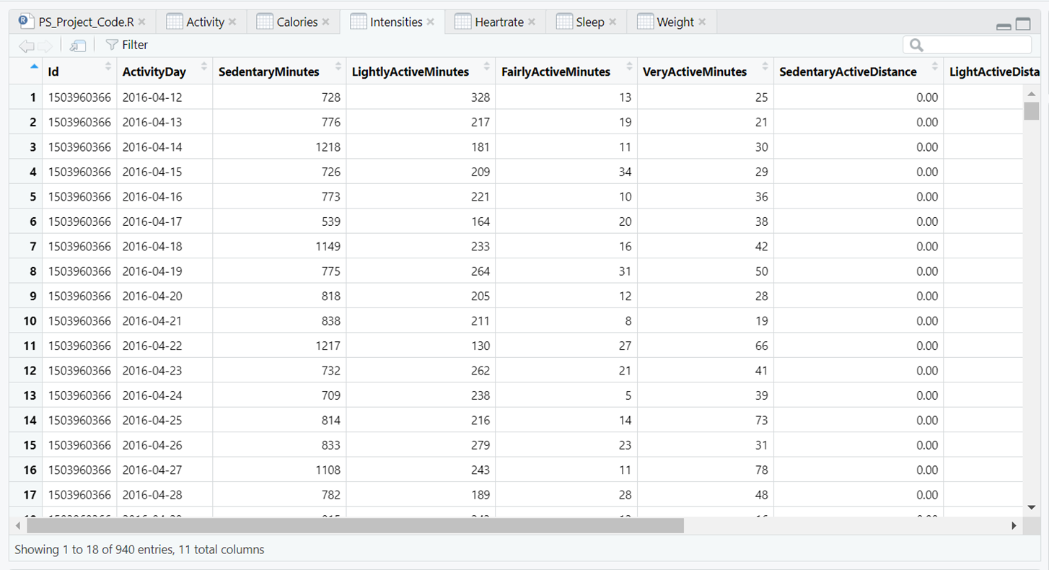
SNEEK PEEK OF THE DATASETS
weightLogInfo_merged.csv
dailyAcitivity_merged.csv
sleepDay_merged.csv
dailyIntensities_merged.csv

Slide 6
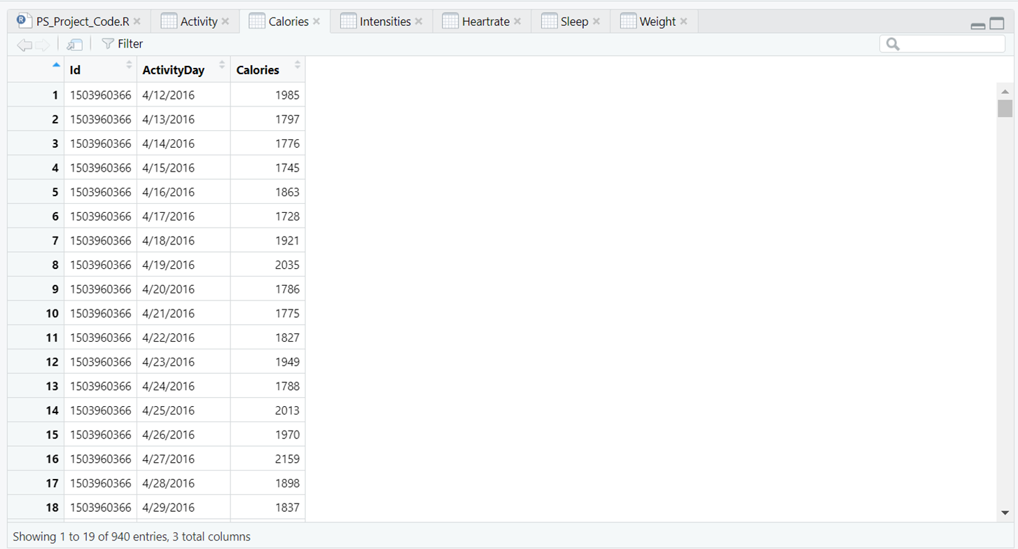
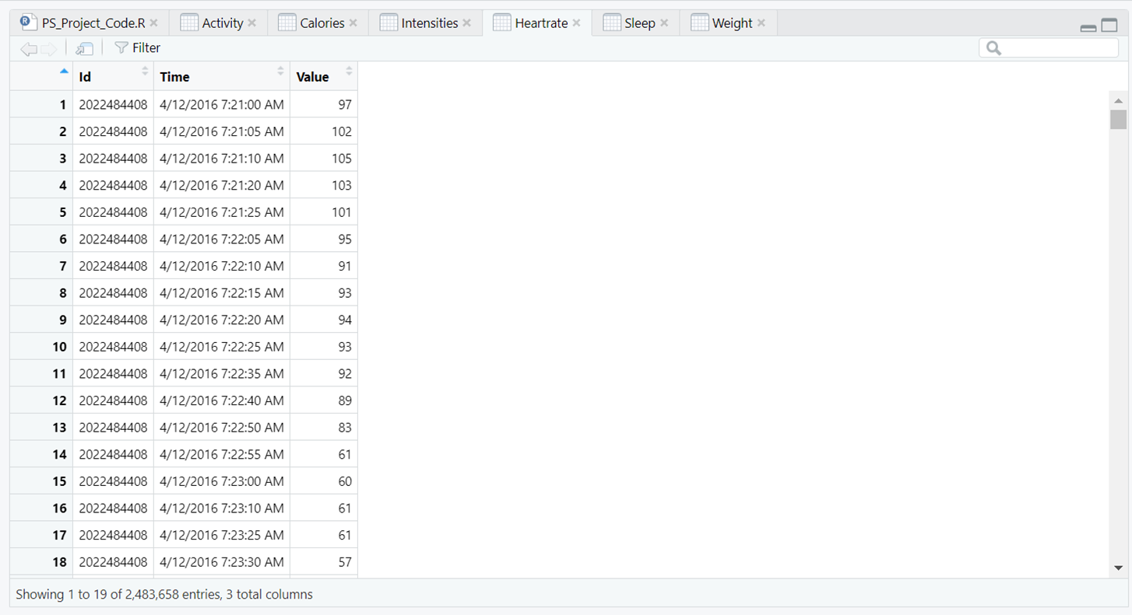
SNEEK PEEK OF THE DATASETS
dailyCalories_merged.csv
heartrate_seconds_merged.csv

Slide 7
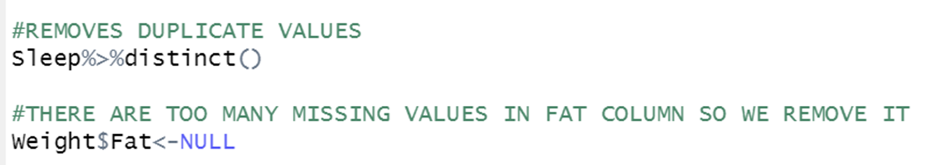
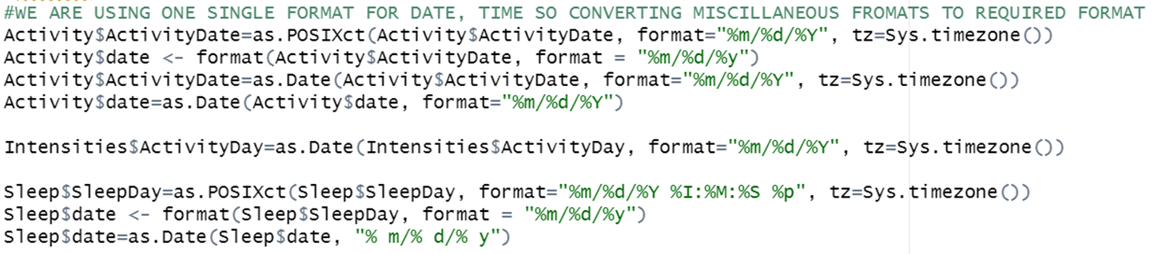

DATA CLEANING
De-duplicating and Removing Null Values
Formatting

Slide 8
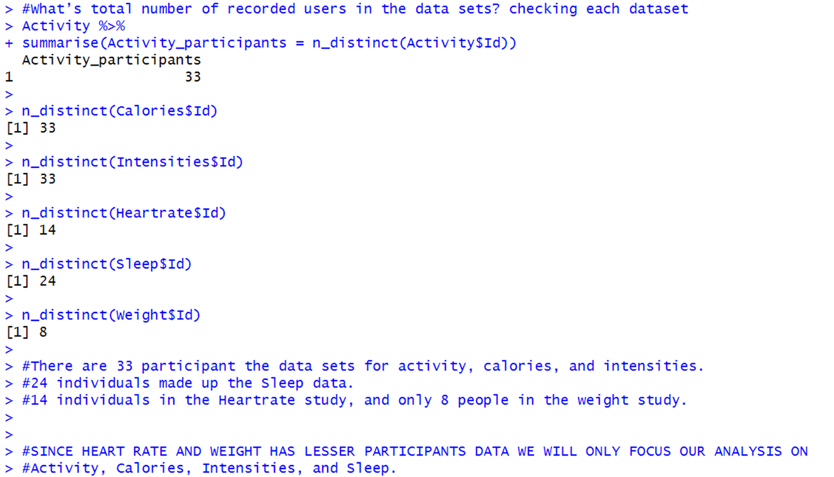
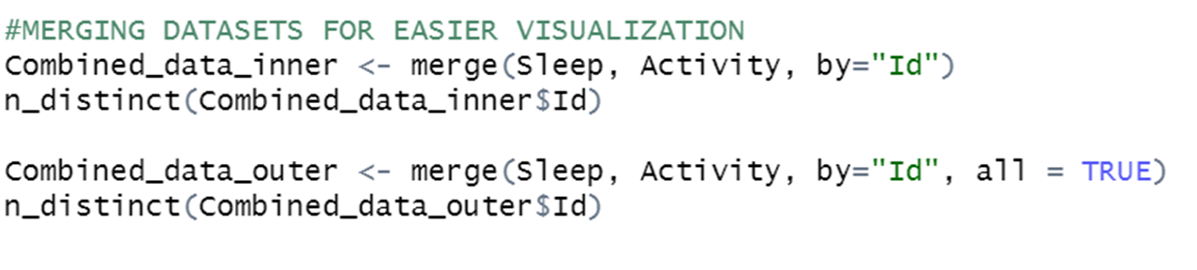

DATA ANALYSIS
What is the total number of recorded users in each of the datasets?

Slide 9
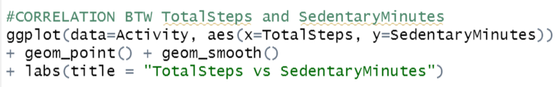
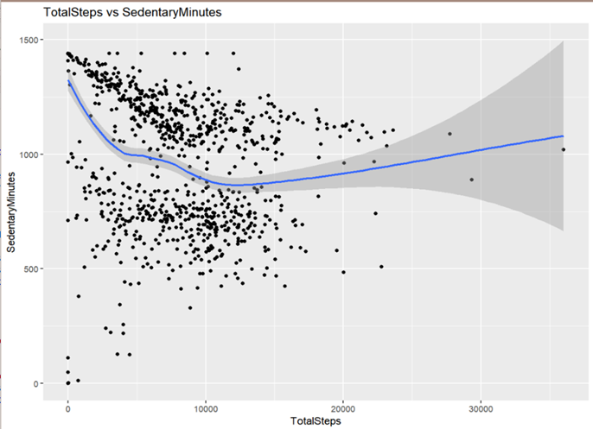
ANALYZING THE CORRELATION PATTERNS
Relationship between Steps Taken in a day
and Sedentary Minutes
Correlation between steps taken in a day and sedentary minutes is -0.3274835.
They have a weak negative relation.
Less steps are taken throughout the day as participants spend more time sitting down.
This data information demonstrates the need for the business to promote the product to client groups that spend a lot of time sitting down.
And to accomplish that, the business must identify means of finding clients to increase their walking and tracking their daily steps & activities.

Slide 10
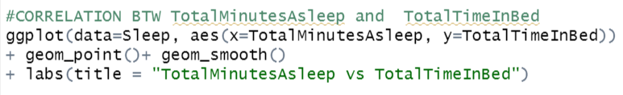
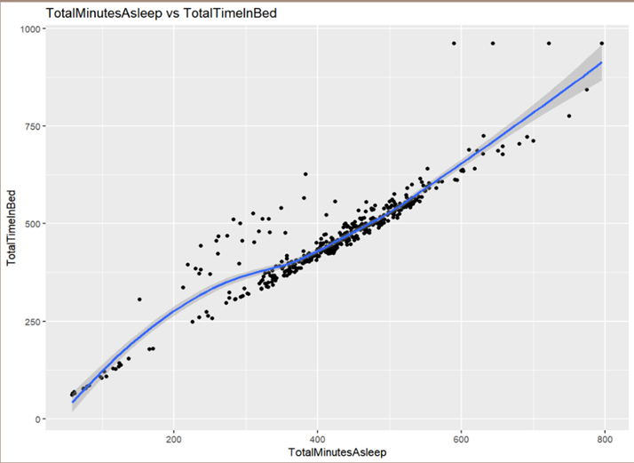
ANALYZING THE CORRELATION PATTERNS
Relationship between Minutes Asleep
and Total Time In Bed
Correlation between Minutes Asleep and Time in Bed is 0.9304575
They have a very strong positive relation.
The more time is spent in bed, the more time the participants are asleep.
The business should create a personal notification to go to sleep at specific time or help users get better sleep time.

Slide 11
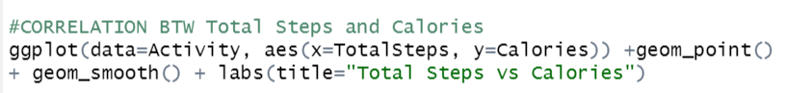
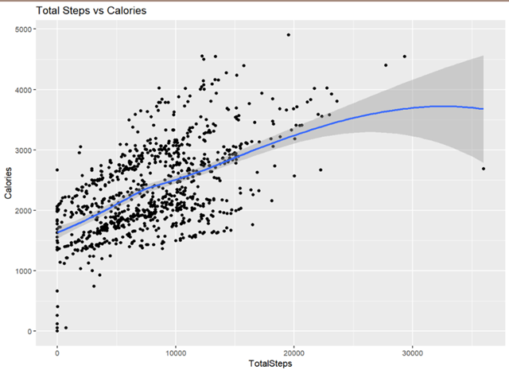
ANALYZING THE CORRELATION PATTERNS
Relationship between Total Steps
and Calories
Correlation between Total Steps and Calories is 0.5915681
They have a strong positive relation.
the more participants act, the more calories burned.
The business could make use of this to encourage participants to walk more by incorporating a calorie counter into the fitness band.

Slide 12
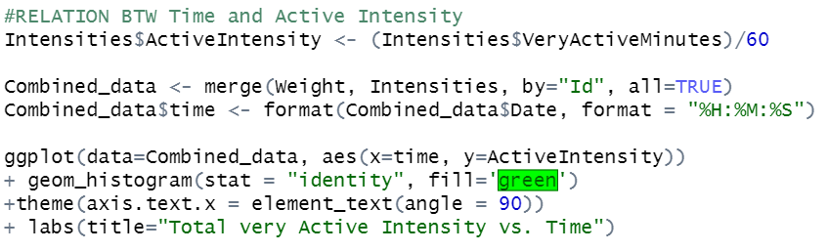
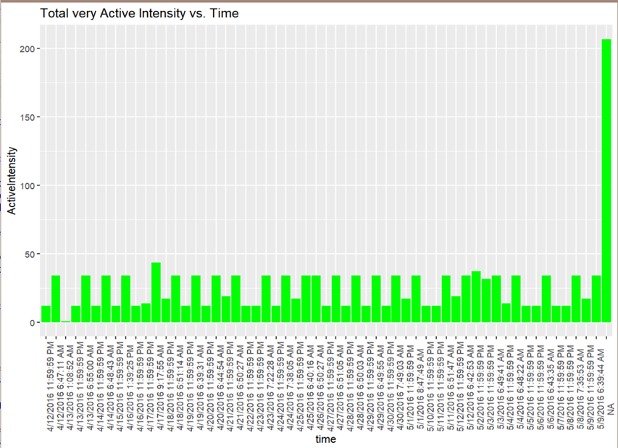
ANALYZING THE CORRELATION PATTERNS
Intensities Data over Time
By analyzing some time-series data on intensity,
We can see how customers use their product throughout the day.
From the data it can be inferred that
majority of users are active before and
after work.
The business can utilize this time to remind and encourage customers to go for a run or an activity by sending a notification.

Slide 13

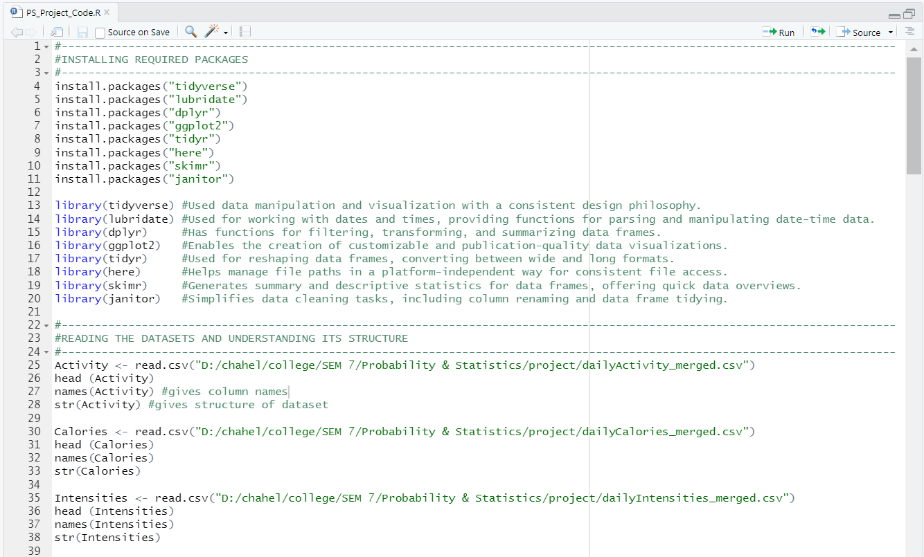
INPUT CODE

Slide 14

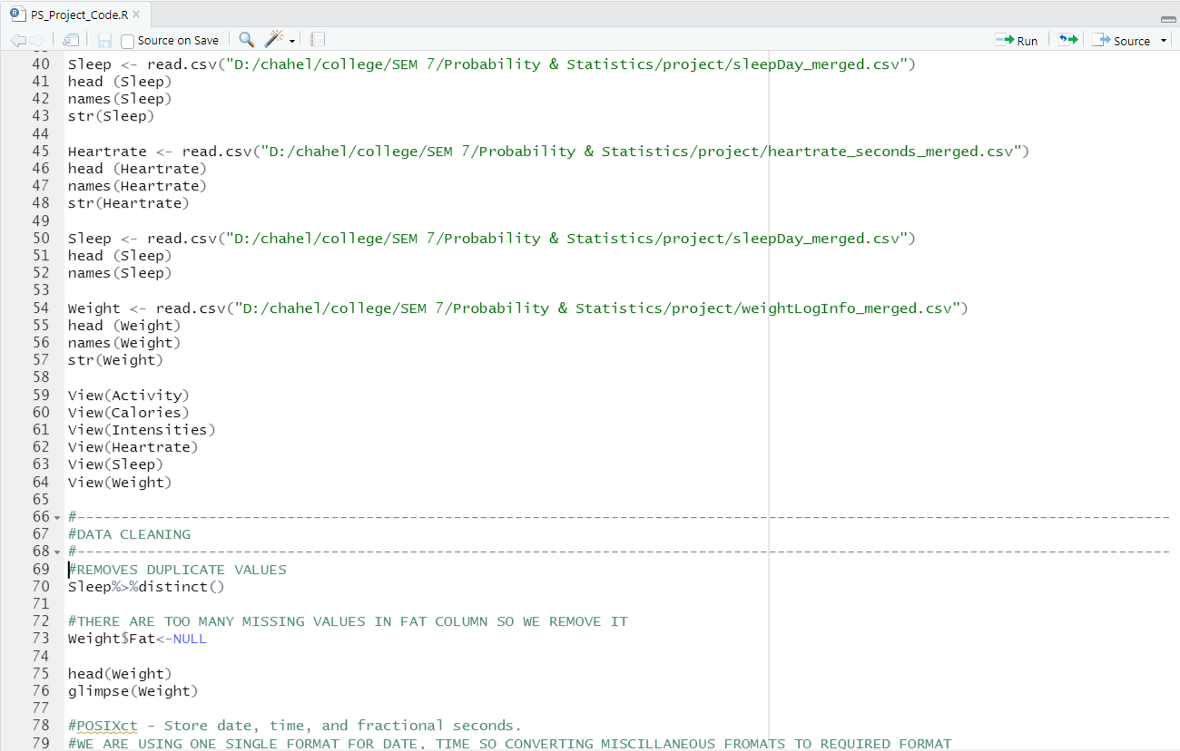

Slide 15
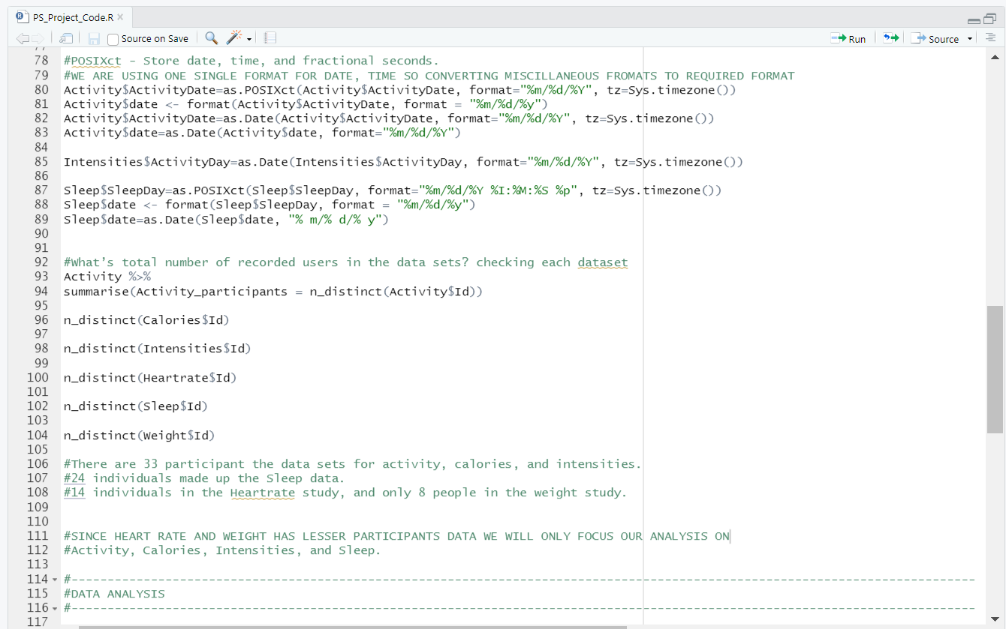

Slide 16
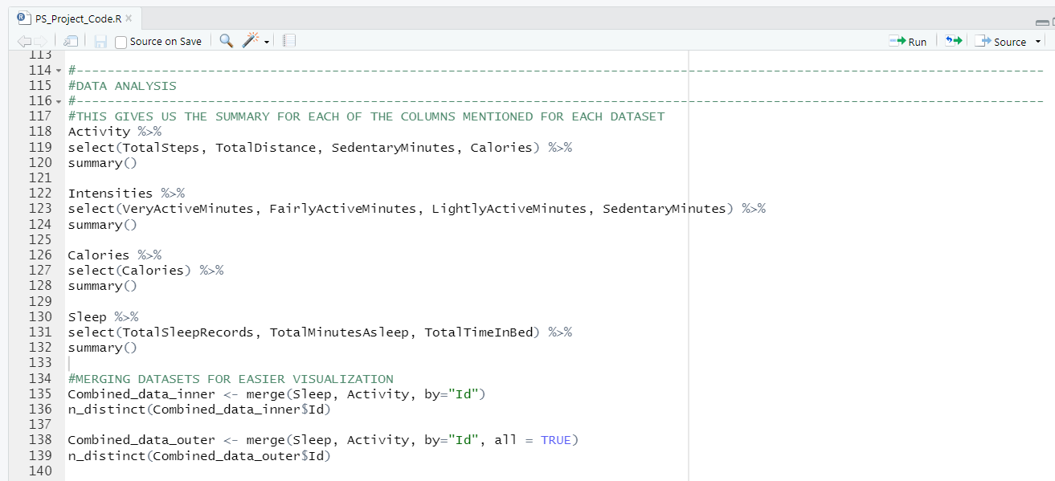

Slide 17
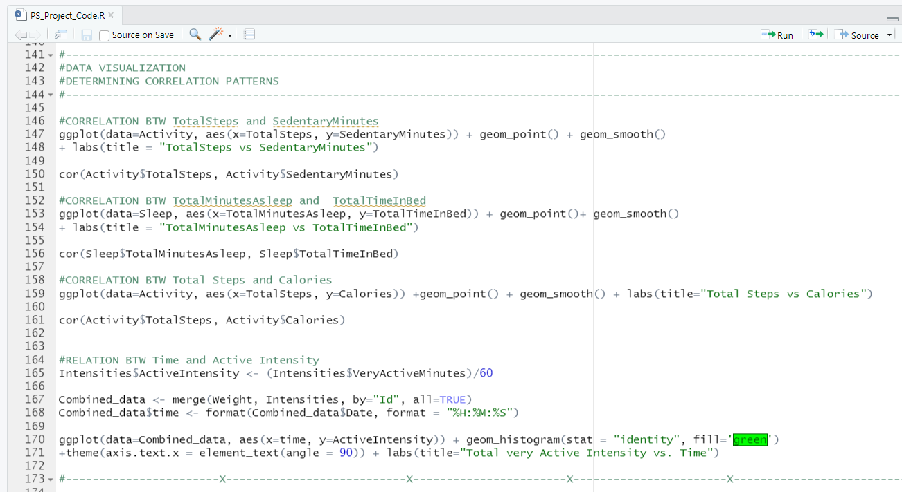
Coded on R Studio

Slide 18
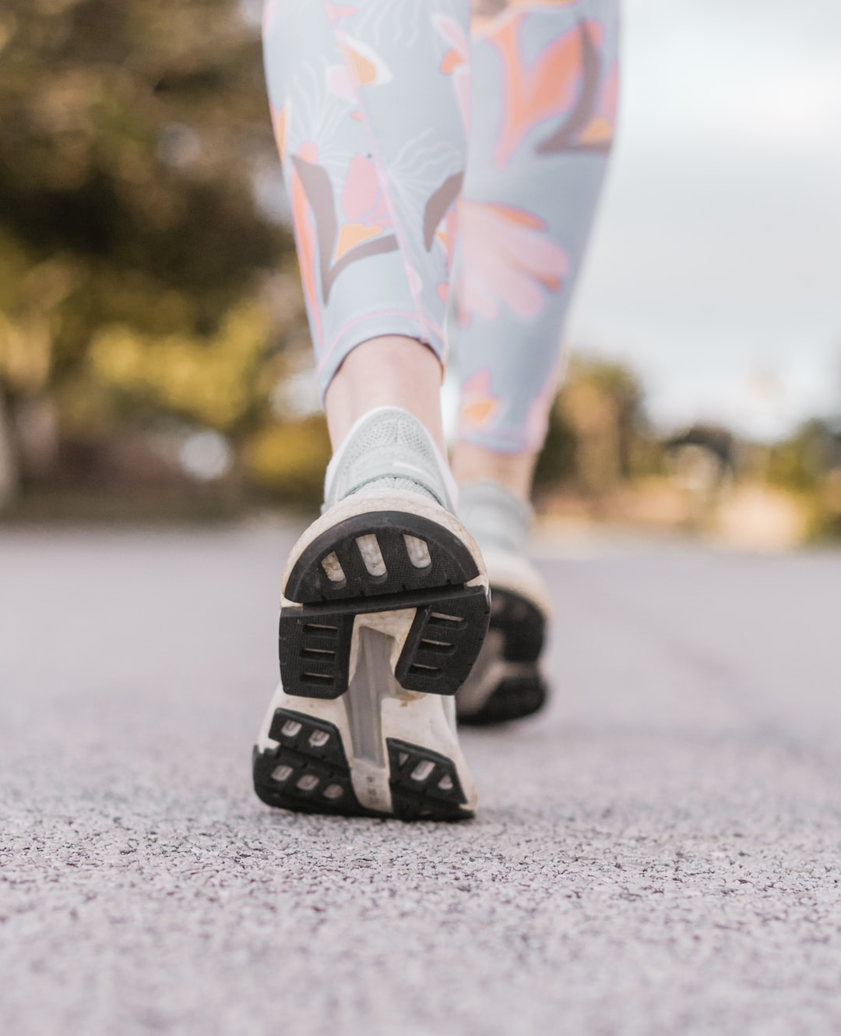
CONCLUSION
Correlation analysis has helped us determine how to develop a fitness tracker. The data includes from the analysis done through the graphs in the above slides, leveraging data insights on activity, sleep, and stress enables businesses to offer personalized health knowledge, particularly targeting individuals with full-time employment and sedentary lifestyles.
To address this, marketing strategies should emphasize the promotion of active hours and the establishment of healthy habits. The envisioned fitness tracker is recommended to be a personalized and adaptive, serving as a companion in managing personal and professional lives. Key considerations include tailored health reminders and the cultivation of strong habits.

Slide 19
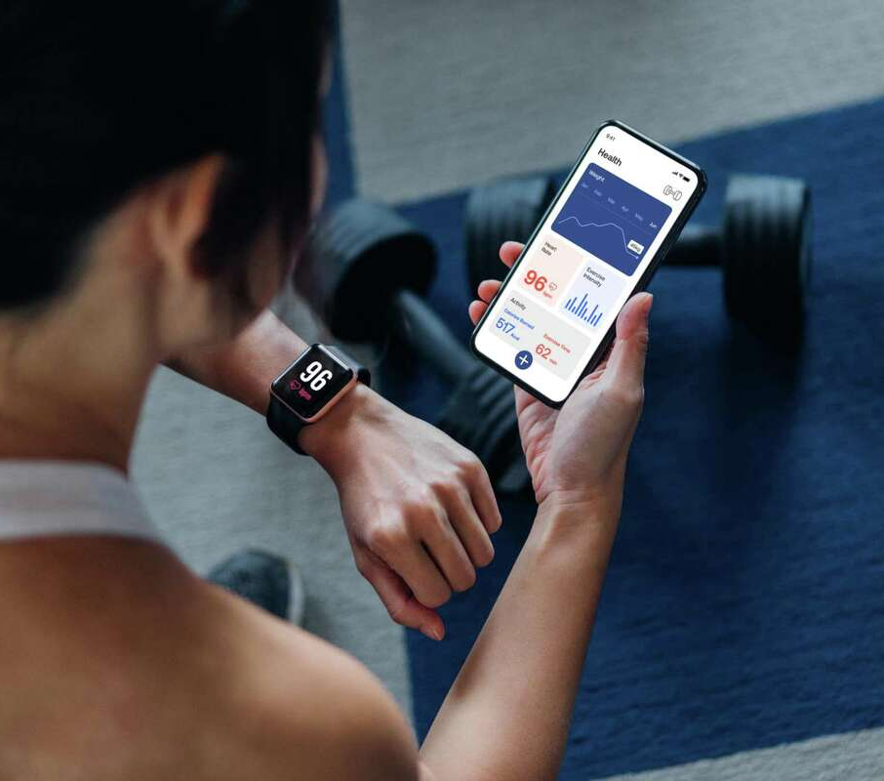
THANK YOU
Student Details:
C049 - Chahel Gupta
C050 - Vivean Arya
C051 - Siddh Patel
B.Tech Integrated (Computers)
Year IV, Semester VII
Divison B, Batch B2
Dataset:
Arashnic (2020). Fitbit Dataset. Kaggle. https://www.kaggle.com/datasets/arashnic/fitbit
Other References:
Dhariwal, K. (2018). Top R libraries for Data Science. Towards Data Science. https://towardsdatascience.com/top-r-libraries-for-data-science-9b24f658e243
Statistics Solutions. Directory of Statistical Analyses: Correlation (Pearson, Kendall, Spearman). https://www.statisticssolutions.com/free-resources/directory-of-statistical-analyses/correlation-pearson-kendall-spearman/

